Slide 1
CLUSTERING

Slide 2
K-MEANS CLUSTERING
1. What is K-Means
K-Means is an unsupervised clustering algorithm that partitions data into K clusters, where each data point belongs to the cluster with the nearest centroid.

Slide 3
2. Purpose
To group similar data points together based on distance, minimizing intra-cluster variance.

Slide 4
3. Why it is Used
Simple and fast
Scales well to large datasets
Easy to implement and interpret
Effective when clusters are spherical

Slide 5
4. How K-Means Works (Algorithm)
Choose number of clusters K
Randomly initialize K centroids
Assign each data point to nearest centroid
Recompute centroids as cluster mean
Repeat until convergence

Slide 6
5. Formula
Objective Function (Within-Cluster Sum of Squares):
J=∑i=1K∑x∈Ci∥x−μi∥^2
Where:
Ci​ = cluster
μi = centroid

Slide 7
6. Technical Details
Distance metric: Euclidean
Convergence when centroids stop moving
Sensitive to initialization

Slide 8
7. Parameters
Parameter | Meaning
n_clusters (K) | Number of clusters
init | Centroid initialization
max_iter | Maximum iterations
tol | Convergence threshold

Slide 9
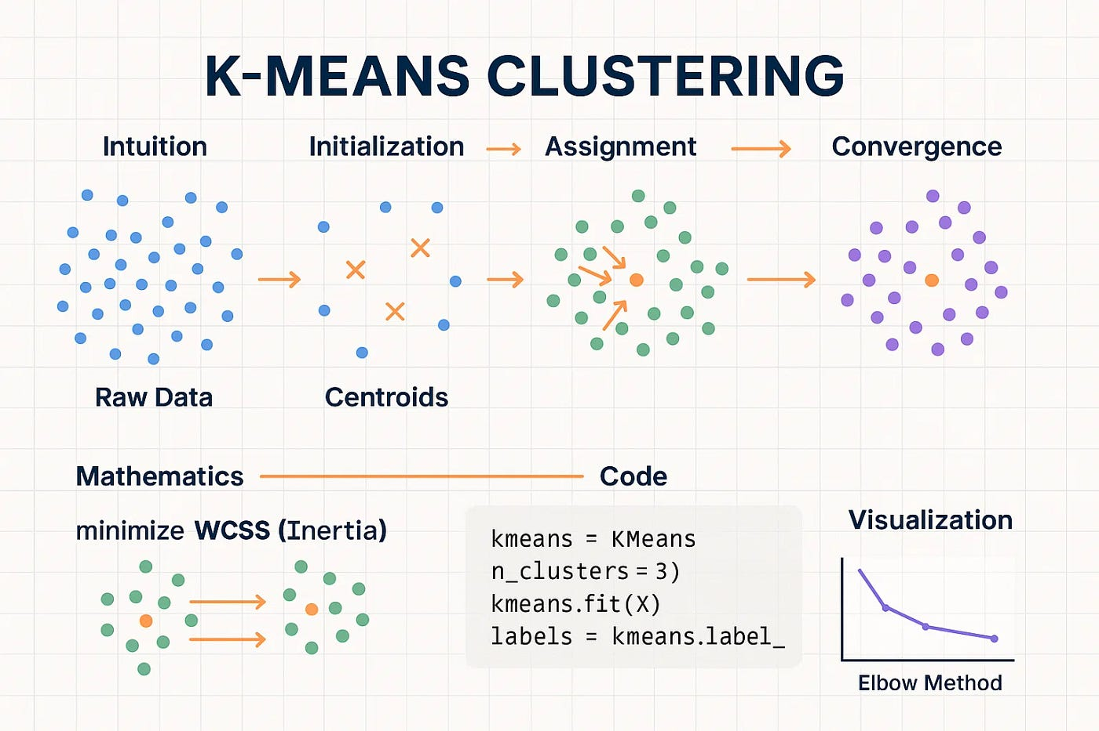

Slide 10
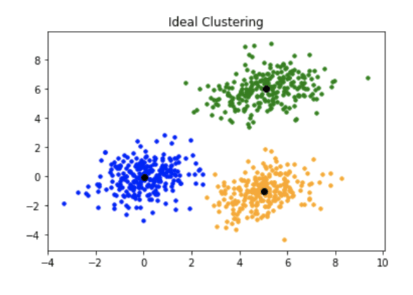

Slide 11
8. Pros
Fast and scalable
Easy to understand
Efficient for large datasets

Slide 12
9. Cons
Must choose K beforehand
Sensitive to outliers
Fails on non-spherical clusters
Sensitive to initialization

Slide 13
10. Real-World Applications
Customer segmentation
Image compression
Market basket analysis
Document clustering

Slide 14
Summary
K-Means groups data into K distance-based clusters by minimizing within-cluster variance.

Slide 15
HIERARCHICAL CLUSTERING
1. What is Hierarchical Clustering
Hierarchical Clustering builds a tree-like structure (dendrogram) that represents nested clusters without requiring K beforehand.

Slide 16
2. Purpose
To discover natural grouping structures and cluster hierarchy in data.

Slide 17
3. Why it is Used
No need to predefine number of clusters
Produces interpretable dendrogram
Works well for small datasets

Slide 18
4. How Hierarchical Clustering Works
Types:
Agglomerative (Bottom-Up)
Divisive (Top-Down)
Agglomerative Algorithm:
Start with each point as its own cluster
Merge closest clusters
Repeat until one cluster remains
Cut dendrogram at desired level

Slide 19
5. Formula
Ward’s Method
ΔESS={n1n2/n1+n2}∥μ1−μ2∥^2

Slide 20
6. Technical Details
Time complexity: O(n³) (naive)
Memory intensive
Distance matrix required

Slide 21
7. Parameters
Parameter | Meaning
linkage | Merge criterion
metric | Distance measure
n_clusters | Optional

Slide 22
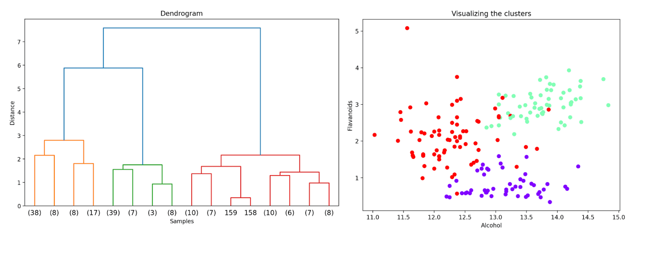

Slide 23
8. Pros
No K required initially
Interpretable hierarchy
Deterministic results

Slide 24
9. Cons
Not scalable
Sensitive to noise
Cannot undo merges

Slide 25
10. Real-World Applications
Biological taxonomy
Document classification
Gene expression analysis

Slide 26
Summary
Hierarchical clustering builds nested clusters represented as a dendrogram.

Slide 27
DBSCAN (Density-Based Spatial Clustering)
1. What is DBSCAN
DBSCAN is a density-based clustering algorithm that groups points in high-density regions and labels sparse points as outliers.

Slide 28
2. Purpose
To identify arbitrarily shaped clusters and detect noise automatically.

Slide 29
3. Why it is Used
No need to specify number of clusters
Handles noise naturally
Detects non-spherical clusters

Slide 30
4. How DBSCAN Works (Algorithm)
Select parameters ε (epsilon) and MinPts
Identify core points
Expand clusters from core points
Label non-reachable points as noise

Slide 31
5. Definitions
Core Point: ≥ MinPts within ε radius
Border Point: reachable but not core
Noise Point: not reachable

Slide 32
6. Technical Details
Distance-based density estimation
Sensitive to ε choice
Struggles with varying densities

Slide 33
7. Parameters
Parameter | Meaning
eps (ε) | Neighborhood radius
min_samples | Min points for core
metric | Distance measure

Slide 34
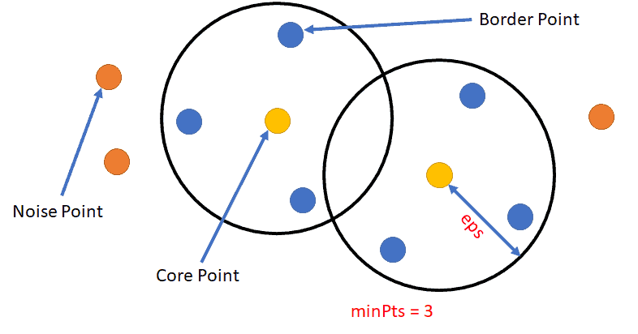

Slide 35
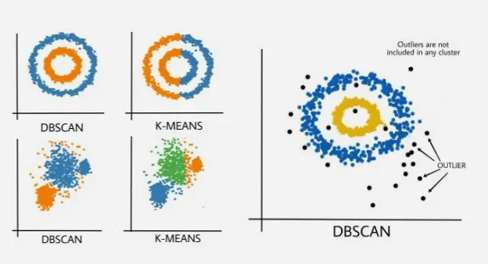

Slide 36
8. Pros
No K required
Detects noise/outliers
Finds complex shapes

Slide 37
9. Cons
Poor with varying densities
Parameter tuning is hard
Struggles in high dimensions

Slide 38
10. Real-World Applications
Anomaly detection
GPS location clustering
Image segmentation
Fraud detection

Slide 39
Summary
DBSCAN clusters data based on density, naturally detecting outliers and complex shapes.

Slide 40
FINAL COMPARISON
Algorithm | K Required | Shape | Noise Handling | Scalability
K-Means | Yes | Spherical | ❌ | Excellent
Hierarchical | No | Any | ❌ | Poor
DBSCAN | No | Any | ✅ | Medium

